Slide 1

Networking Competition Analysis of a Wireshark Trace Nicola DEAN e Marco fasanella

Slide 2
- Sniffing - How to extract data - Create a table - Creative Task 1 - Creative Task 2
SUMMARY

Slide 3

SNIFFING
We called the sniffing function with the following parameters:
filename = ””
prn = ”” a personalized function that will be called for each sniffed packet
- store = 0 to avoid the script from storing all the 800’000 packets on the ram.

Slide 4
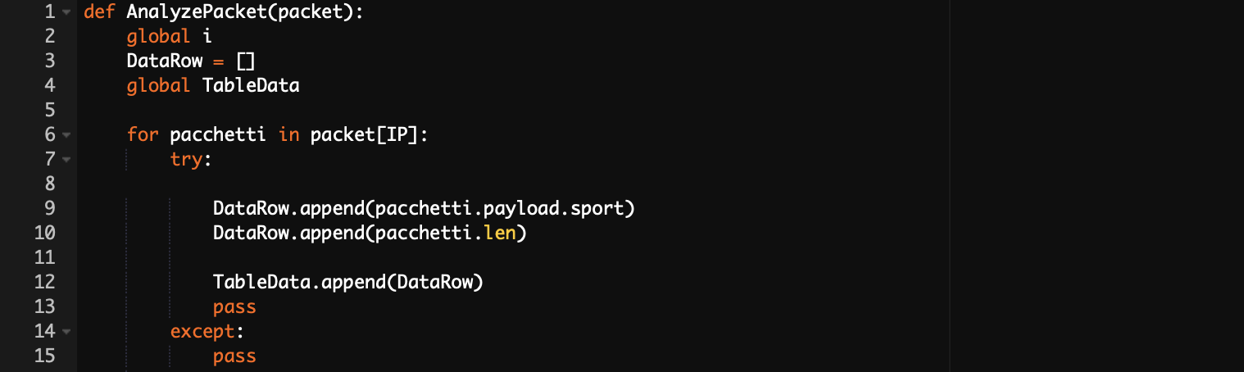
How to extract data
This function will be used to:
Analyze the packets flow
Extract all the required data, in order to be stored in a multidimensional list

Slide 5


Create a Table
Then, the list was converted into a Panda dataframe…
And then it has been modified to analyze the information using some of the most useful functions of panda as “Groupby” or “idxMax”.

Slide 6
Creative Tasks
Finally, we spent hours thinking about an original way to solve the assigned task:
A live graph of the downloading speed of our network
A live graph showing whenever there is a new connection or one is closed

Slide 7
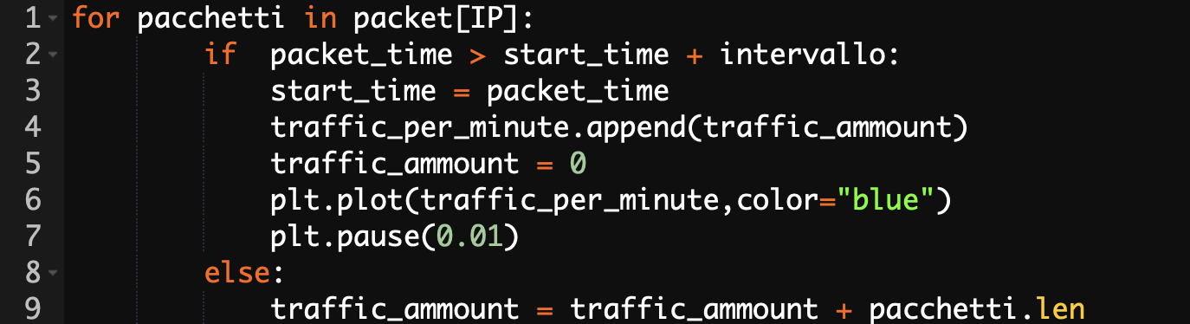
Creative task 1
For the first task the time field in packet class was extracted from the specific timestamp of the Wireshark sniffing session.
With the following code, a simple way to sum the length of the traffic is now possible.
With a specific time range the connection speed can be calculated.

Slide 8

Creative task 1

Slide 9
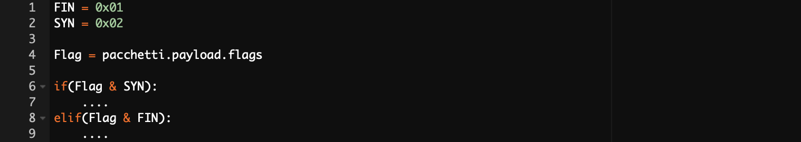
Creative task 2
For the second task a bit to bit “&”(and) is used to extract flags data from “flags” field and understand when a specific flag is on or off.
Using this information, a live scatter graph can now be drawn with a specific height for each different event:
SYN=0 and FIN=0 (Nothing) -> Zero Level
SYN=0 and FIN=1 (connection closed) -> Mid Level
SYN=1 and FIN=0 (connection open) -> Max Level

Slide 10
Creative task 2

Slide 11
Thank You!

